Slide 1
Group 5
Code for this assignment at
https://github.com/TetroVolt/COSC3337Assign2

Slide 2




Who we are
Raymond Sutrisno
Niels Moeller
Gal Egozi
Colby Kuhnel

Slide 3
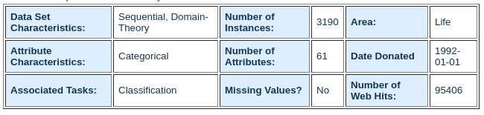
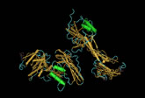
Data Set I (Molecular Biology Data Set)
Introns do not code for proteins
Exons code for proteins

Slide 4
Data Set II: Preliminary analysis
Each Sequence is 60 base pairs long
8 possible base pairs: ('A', 'C', 'D', 'G', 'N', 'R', 'S', 'T')
Three Class Labels
Exon-Intron Boundaries (EI) (767 examples)
Intron-Exon Boundaries (IE) (768 examples)
Neither (N) (1655 examples)

Slide 5
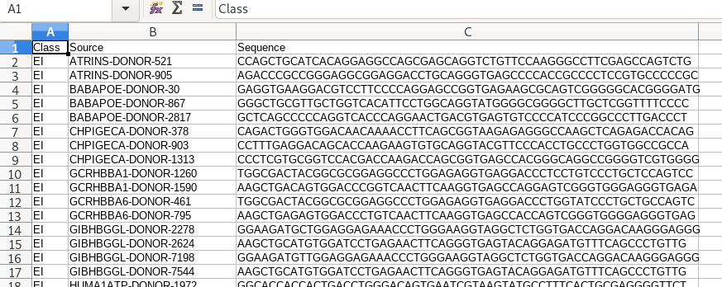
Data Preprocessing I (RAW data)

Slide 6
Algorithms considered
Required:
Neural Networks (Gal Egozi)
Support Vector Machines (Colby Kuhnel)
Chosen freely:
Decision Tree (Niels Moeller)
Random Forest (Raymond Sutrisno)

Slide 7
Data Processing II (considerations)
NN and SVM are “One vs. All” algorithms
Features are categorical in nature
Need One Hot Encoding for both class labels and features

Slide 8
Data Processing III (procedure)
One hot encode features
Each Sequence is 60 base pairs long and categorical
60 features
8 base pair categories ('A', 'C', 'D', 'G', 'N', 'R', 'S', 'T')
60 * 8 = 480 columns total after one hot encoding
One hot encode classes for algorithms that need it
Three classes: ‘EI’ , ‘IE’, ‘N’

Slide 9
Training Procedure
Gridsearch model parameters to tune for the best model using stratified 10 fold cross validation
Report accuracies (CV mainly, training and test)
Optional metrics considered
Confusion Matrices
Learning Curves

Slide 10
Implementation Info
Language used: Python
Utility Libraries:
Pandas (data processing)
Numpy (data processing)
Scikit Learn (data processing)
Machine Learning Libraries
Scikit Learn (SVM, Random Forest, Decision Tree)
Keras (Neural networks)

Slide 11
Results

Slide 12
Random Forest (trees based on C4.5)

Slide 13
Random Forest I (model parameter space available)
Criterion [‘gini’, ‘entropy’]
Max_depth
Min sample splits
Min impurity decrease
...

Slide 14
Random Forest I (model parameter space used)
'N_estimators':[25, 50, 100, 150]
'max_depth': [2, 4, 8, 16, 32, 64]

Slide 15
Random Forest II (Raw Output) (20 % Test)
Dataset characteristics:
Number of examples in the dataset = 3190
Number of examples reserved for test set = 638
Number of examples reserved for training via 10 fold CV = 2552
Class Distribution Ratio (N : EI : IE) = 2 : 1 : 1
N features : 60, all categorical (DNA base pairs in 60 base pair long sequence)
Grid Search parameter space for Random Forest =
{'n_estimators': [25, 50, 100, 150], 'max_depth': [2, 4, 8, 16, 32, 64]}
best estimator parameters found = {'max_depth': 32, 'n_estimators': 150}
best estimator mean training score = 0.9995646116203684
best estimator mean validation score = 0.9114420062695925
best estimator test score = 0.9247648902821317

Slide 16
Random Forest III (Raw Output) (50 % Test)
Dataset characteristics:
Number of examples in the dataset = 3190
Number of examples reserved for test set = 1595
Number of examples reserved for training via 10 fold CV = 1595
Class Distribution Ratio (N : EI : IE) = 2 : 1 : 1
N features : 60, all categorical (DNA base pairs in 60 base pair long sequence)
Grid Search parameter space for Random Forest =
{'n_estimators': [25, 50, 100, 150], 'max_depth': [2, 4, 8, 16, 32, 64]}
best estimator parameters found = {'max_depth': 16, 'n_estimators': 100}
best estimator mean training score = 0.9992337891743421
best estimator mean validation score = 0.8915360501567398
best estimator test score = 0.8984326018808777

Slide 17
Random Forest IV (Raw Output) (70 % Test)
Dataset characteristics:
Number of examples in the dataset = 3190
Number of examples reserved for test set = 2233
Number of examples reserved for training via 10 fold CV = 957
Class Distribution Ratio (N : EI : IE) = 2 : 1 : 1
N features : 60, all categorical (DNA base pairs in 60 base pair long sequence)
Grid Search parameter space for Random Forest =
{'n_estimators': [25, 50, 100, 150], 'max_depth': [2, 4, 8, 16, 32, 64]}
best estimator parameters found = {'max_depth': 16, 'n_estimators': 100}
best estimator mean training score = 1.0
best estimator mean validation score = 0.8610240334378265
best estimator test score = 0.8669950738916257

Slide 18
Random Forest Best Parameters
Train : Test Ratio | Max Depth | N Estimators
80:20 | 32 | 150 (MAX)
50:50 | 16 | 100
30:70 | 16 | 100

Slide 19
Random Forest Mean Scores
Train : Test Ratio | Mean Train | Mean CV | Test Score
80:20 | 0.9995 | 0.9114 | 0.9247
50:50 | 0.9992 | 0.8915 | 0.8984
30:70 | 1.0000 | 0.8610 | 0.8669

Slide 20
Random Forest Mean Scores
Train : Test Ratio | Mean Train | Mean CV | Test Score | Max Depth | N Estimators
80:20 | 0.9995 | 0.9114 | 0.9247 | 32 | 150
50:50 | 0.9992 | 0.8915 | 0.8984 | 16 | 100
30:70 | 1.0000 | 0.8610 | 0.8669 | 16 | 100

Slide 21
Decision Tree (SKLearn based on C4.5)

Slide 22
Decision Trees 80/20
Dataset characteristics:
Number of examples in the dataset = 3190
Number of examples reserved for test set = 638 Number of examples reserved for training via 10 fold CV = 2552 Class Distribution Ratio (N : EI : IE) = 2 : 1 : 1 N features : 60, all categorical (DNA base pairs in 60 base pair long sequence)
Grid Search parameter space for Random Forest = {'max_depth': range(3, 20)} best estimator parameters found = {'max_depth': 6} best estimator mean training score = 0.9573321284086651 best estimator mean validation score = 0.9455329153605015 best estimator test score = 0.9404388714733543

Slide 23
Decision Tree Scores
Train : Test Ratio | Mean Train | Mean CV | Test Score
80:20 | 0.9570 | 0.9447 | 0.9341
50:50 | 0.9484 | 0.9347 | 0.9373
30:70 | 0.9564 | 0.9362 | 0.9305

Slide 24
Decision Tree Best Parameters
Train : Test Ratio | Max Depth (3-20) | Min samples split [3,5,25]
80:20 | 5 | 25
50:50 | 5 | 3
30:70 | 6 | 3

Slide 25
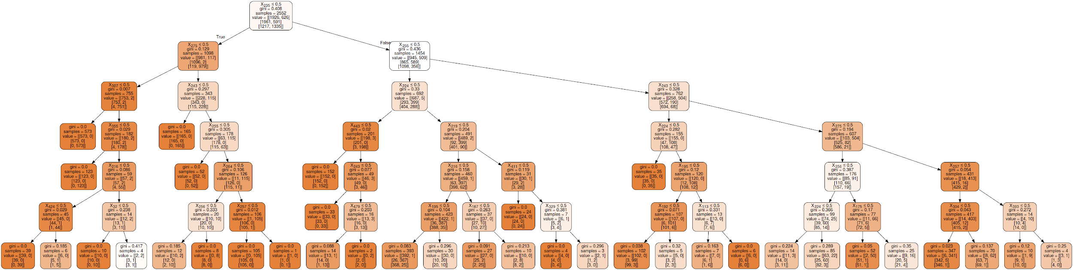
Resulting Decision Tree

Slide 26
SVM

Slide 27
Support Vector Machines (20% Test)
Grid Search parameter space for SVM = [{'C': [100, 1000, 10000], 'gamma': [0.01, 0.001], 'kernel': ['poly', 'rbf'], 'degree': [2, 3, 4]}]
best estimator parameters found = {'C': 100, 'degree': 3, 'gamma': 0.01, 'kernel': 'poly'}
best estimator mean training score = 0.9996081466330754
best estimator mean validation score = 0.9678683385579937
best estimator test score = 0.9702194357366771
Process Time = 8.436292 Minutes

Slide 28
Support Vector Machines (50% Test)
Grid Search parameter space for SVM = [{'C': [100, 1000, 10000], 'gamma': [0.01, 0.001], 'kernel': ['poly', 'rbf'], 'degree': [2, 3, 4]}]
best estimator parameters found = {'C': 100, 'degree': 3, 'gamma': 0.01, 'kernel': 'poly'}
best estimator mean training score = 0.9994427513515088
best estimator mean validation score = 0.9605015673981191
best estimator test score = 0.9661442006269593
Process Time = 3.845329 Minutes

Slide 29
Support Vector Machines (70% Test)
Grid Search parameter space for SVM = [{'C': [100, 1000, 10000], 'gamma': [0.01, 0.001], 'kernel': ['poly', 'rbf'], 'degree': [2, 3, 4]}]
best estimator parameters found = {'C': 100, 'degree': 3, 'gamma': 0.01, 'kernel': 'poly'}
best estimator mean training score = 1.0
best estimator mean validation score = 0.9540229885057471
best estimator test score = 0.961486789072996
Process Time = 1.603256 Minutes

Slide 30
Support Vector Machines Mean Scores
Train : Test Ratio | Mean Train | Mean CV | Test Score
80:20 | 0.9996 | 0.9679 | 0.9702
50:50 | 0.9994 | 0.9605 | 0.9661
30:70 | 1.0 | 0.9540 | 0.9615

Slide 31
Neural Network

Slide 32
Neural Network
One layer, 50 nodes
Scores 95.52±0.74% on stratified cross validation
20% test
99.61% Train
94.36% Test
50% test
99.44% Train
93.67 Test
70% test
100% train
91.49% test

Slide 33
Performance Comparison

Slide 34
Top Dog for 20% Test
Algorithm | Best Test Score | Accompanying CV Score | Accompanying Train Score
Random Forest | 0.9247 | 0.9114 | 0.9995
Decision Tree | 0.9373 | 0.9347 | 0.9484
SVM 🐶🔥💯 | 0.9702 👑 | 0.9679 👑 | 0.9996 👑
Neural Network | 0.9436 | 0.9552 | 0.9961

Slide 35
Top Dog for 50% Test
Algorithm | Best Test Score | Accompanying CV Score | Accompanying Train Score
Random Forest | 0.8984 | 0.8915 | 0.9992
Decision Tree | 0.9373 | 0.9347 | 0.9484
SVM 🐶🔥💯 | 0.9661 👑 | 0.9605 👑 | 0.9994 👑
Neural Network | 0.9436 | 0.9552 | 0.9961

Slide 36
Top Dog for 70% Test
Algorithm | Best Test Score | Accompanying CV Score | Accompanying Train Score
Random Forest | 0.8669 | 0.8610 | 1.0000 👔
Decision Tree | 0.9373 | 0.9347 | 0.9484
SVM 🐶🔥💯 | 0.9615 👑 | 0.9540 | 1.0000 👔
Neural Network | 0.9436 | 0.9552 👑 | 0.9961

Slide 37
What could have been done differently?
Investigated Gini importances of features
Investigated other pattern recognition neural network architectures
Investigated learning curves of models to better understand generalization behaviors
Investigated Confusion matrices to see if class distribution was an issue that skewed different types of errors
Used stratified K fold rather than random sample K fold
Played more with parameters in general

Slide 38
Thank you!
End of presentation

